Slide 1
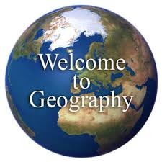
GEOGRAPHY
S.P.I.C.E.S.S
Space
Place
Interconnection
Change
Environment
Sustainability
Scale

Slide 2
Learning intentions

Slide 3
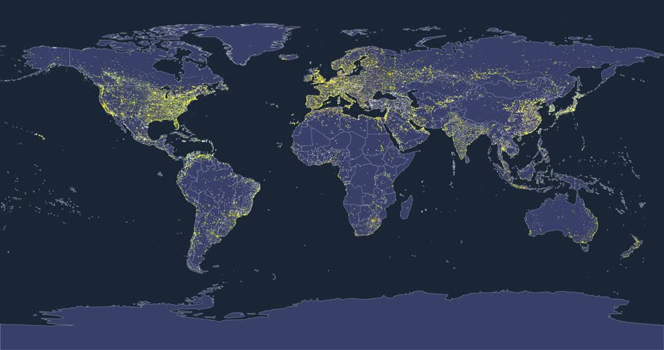
S is for SPACE
Space is a way of identifying how things are arranged on the Earth’s surface
Are there any patterns?

Slide 4
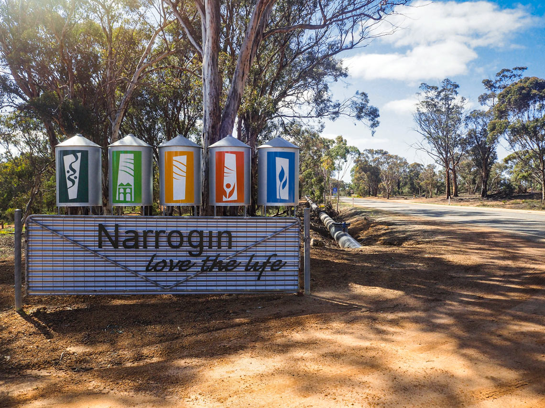
P is for PLACE
Places are parts of the Earth’s surface that is given meaning by people.
Where is it located? What is it like there?
E.g. City, town, desert

Slide 5
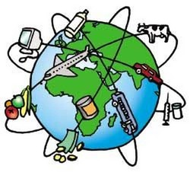
I is for INTERCONNECTION
How places are connected with other places
Events in one location can lead to change in another location
Wars lead to migration
Drought in Canada leads to higher grain prices in Australia
COVID lockdowns over east lead to shipping delays

Slide 6
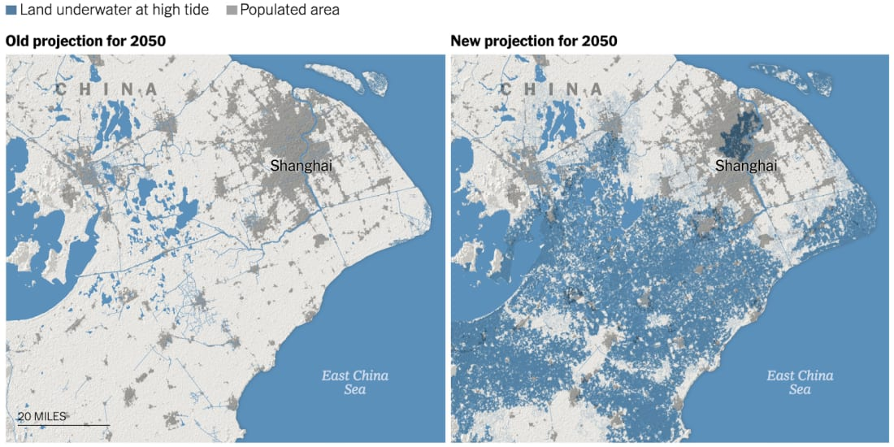
C is for CHANGE
Differences occur over time and place
It can be over a long period of time or a short period of time
Caused naturally or by humans
Can have consequences
Flash floods
Development of fossil fuel resources
Climate change

Slide 7
What are some changes that have taken place over time in your town?

Slide 8
E is for ENVIRONMENT
The world we live in is made up of many different environments
The world around us both natural (physical) and human environments
Today, there are very few truly natural environments on Earth

Slide 9
1. What is a natural environment? Give examples. 2. What is a human environment? Give examples.

Slide 10
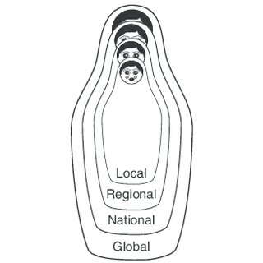
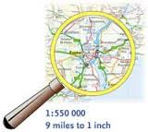
S is for SCALE
Scale is the different levels things can be viewed
Personal and local levels, regional, national and global levels.
Doing things at one scale (i.e. local) can have effects at larger scales (i.e. global)

Slide 11
Name an impact of COVID 19 on these scales: Local- Regional- State- National- International-

Slide 12

S is for SUSTAINABILITY
Sustainability is about maintaining the environment to be able to continue to support future generations
“Can we keep doing this?”
“Are we having an impact on this place?”

Slide 13
Space |  | A part of the Earth’s surface, both natural and built, that is identified and given meaning by people.
Place |  | The way that things do not remain the same over time and place. This can happen over a short or long period of time.
Interconnections |  | The level at which things take place; personal, local, regional, national or global.
Change |  | The ongoing ability of the earth to support future generations.
Environment |  | The relationship (links) between all things and how something in one location can impact another.
Sustainability |  | The natural and human spaces that cover the world. There are very few natural left!
Scale |  | The way things are arranged on the Earth’s surface, how they are organised and how things can create patterns.

